Slide 1
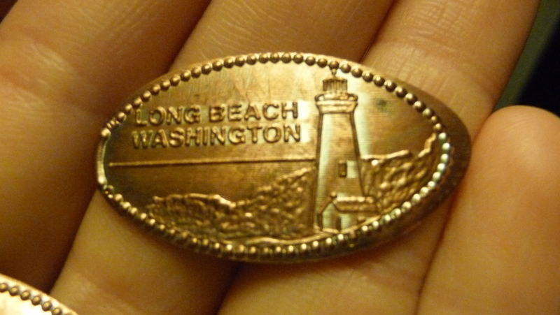
Reproducing His image
Progress through Process
Gen 1:26-28 Gal 4:19

Slide 2
Scriptures
Gen 1:26-28
“Then God said, “Let Us make man in Our image, according to Our likeness…Then God blessed them, and God said to them, “Be fruitful and multiply; fill the earth and subdue it; have dominion over the fish of the sea, over the birds of the air, and over every living thing that moves on the earth.”
Gal 4:19
“My little children, for whom I labour in birth again until Christ is formed in you.”
Notes:
We are made in God’s image and His likeness. He wants to see it imprinted on us.
Imprinting is something that happens in nature? Imprinting is where young animals learn behavioural characteristics from their parents. Consider the Canadian goose. They imprint on their mothers. They learn behaviours such as how to groom themselves, how to find food, how to fly, mating and migration routes. A famous movie made called Fly Away Home tells the story of how a bunch of orphaned Canadian baby geese were safely led along their migration route to North Carolina for the summer. This was successful because the baby geese imprinted on the girl who rescued them. She flew a light winged aircraft and the baby geese followed her.
We are made to bear His image and His likeness. Likeness is the character and behavioural aspects. Likeness is not automatic. It must be learned, it’s a process that you go through (just like imprinting) where Jesus’ characteristics are imprinted on us. We bear resemblance through our mannerisms, our behaviour etc.
Jesus wants to reproduce His likeness in me. Christ must be formed in me.
Rom 12:1-2

Slide 3
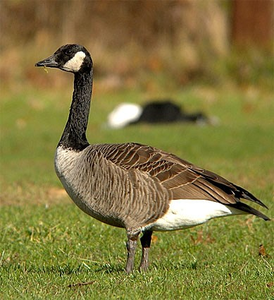
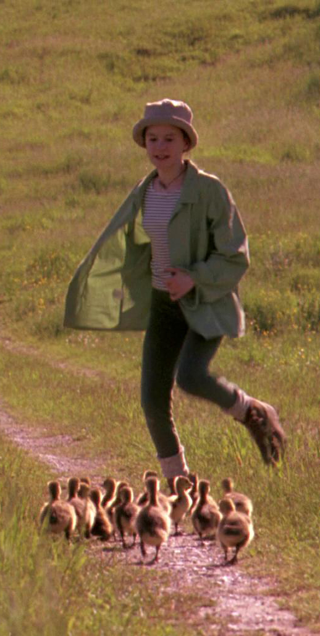
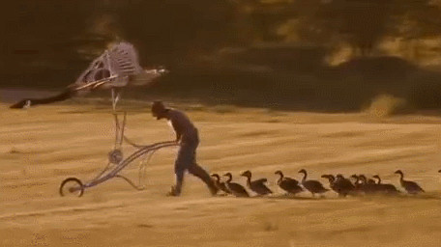
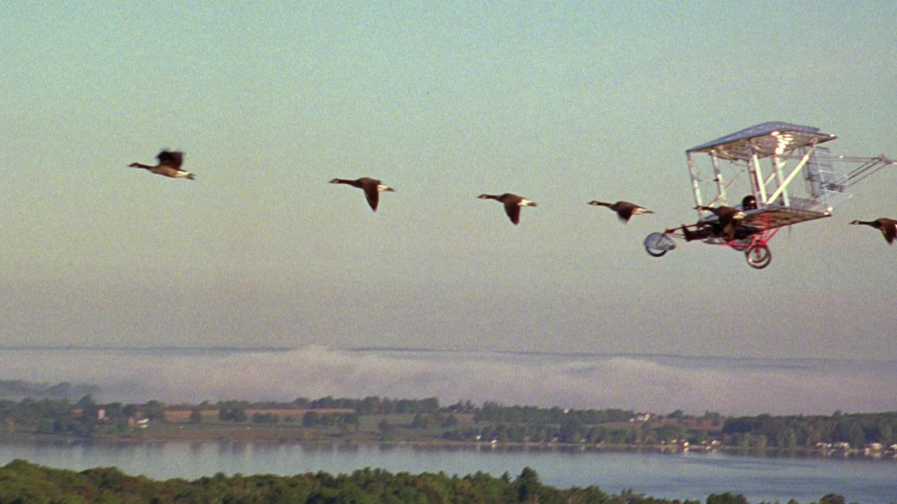
Imprinting
Made in His Image and Likeness

Slide 4
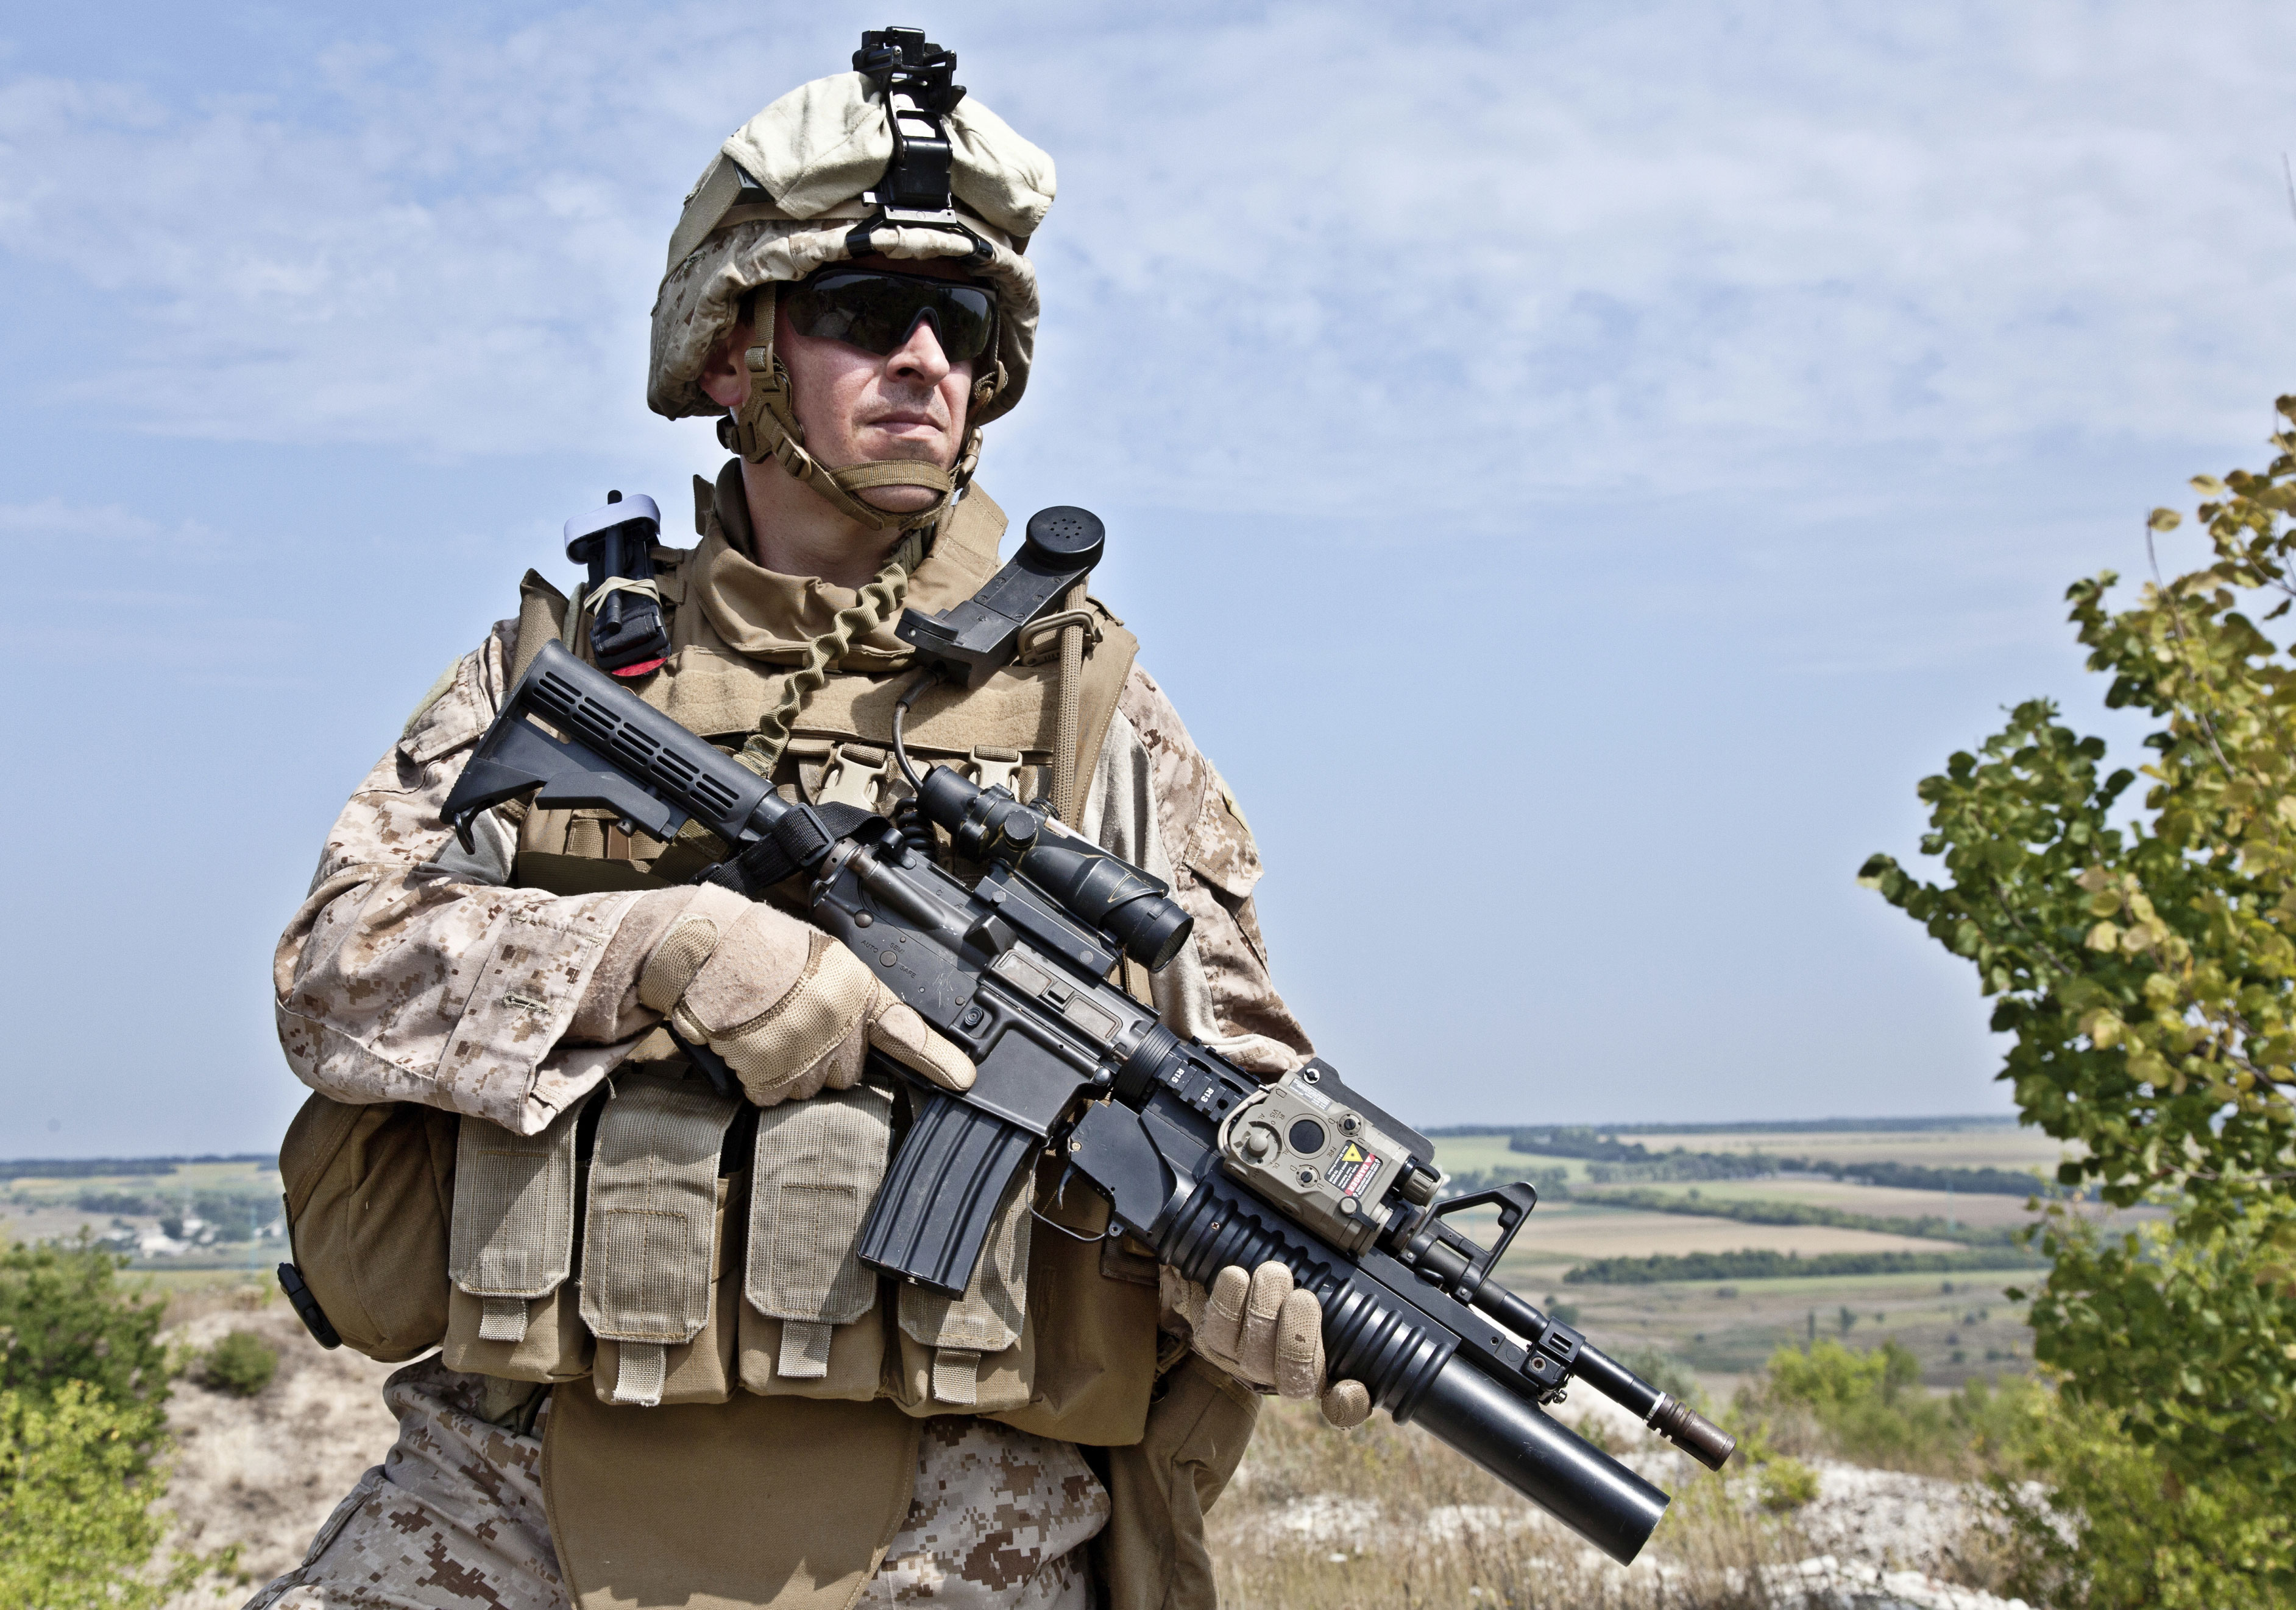

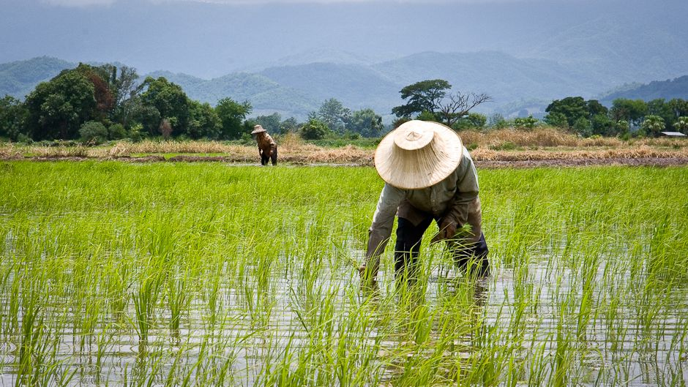
What do these three have in common?
Soldier
Athlete
Farmer
“You therefore must endure hardship as a good soldier of Jesus Christ. No one engaged in warfare entangles himself with the affairs of this life, that he may please him who enlisted him as a soldier. And also if anyone competes in athletics, he is not crowned unless he competes according to the rules. The hardworking farmer must be first to partake of the crops. Consider what I say, and may the Lord give you understanding in all things. 2 Tim 2:3-7
Notes:
Ask –
What is the goal of the soldier? Athlete? Farmer?
What is the mindset of the soldier? Athlete? Farmer?
What attitude does the soldier have? Athlete? Farmer?
Are there times when they feel like they would rather be doing something else? They have this hope that all the work, the training that they are undertaking is going to enable them to be effective, the best and successful.
The goal gives meaning to the process.
Optional notes:
In the key scripture we read earlier (Phil 3), we see that we must forget those things that are behind/the past.
What can happen if a soldier is dwelling on the past? Say for example a previous battle or mission or op that he was involved in. Get responses. ANSWER: They can get distracted from their current mission.
Now think about this scenario…What can happen if an athlete is thinking about the last race or last event where they won a gold medal or achieved a personal best? ANSWER:
How can the soldier, the athlete and the farmer use events of the past in a helpful way? Get responses. ANSWER: To learn from their mistakes, to apply themselves differently/do things differently.
Key points/intent: No experience is ever wasted in God. Failures can teach us what not to do. Equally, if we focus on our past successes or achievements, we also move forward because we are not trying to get better.

Slide 5
“Mental attitude is better than mental ability”Kathryn Kuhlman
Taking God casually
Ps 50:21 – You thought I was altogether like you
Spirit of laziness
Prov 6:6 Go to the ant!
Cares of life
1 John 2:15-17 Love not the world
Taking God seriously
2 Thess 2:10 – Receive a love of the truth
Spirit of diligence
2 Tim 2:15 Be diligent to present yourself to God approved
Care for God’s things
Heb 11:5-6 – Enoch pleased God by walking with Him
Prov 8:17 – Those who diligent seek me will find me
Notes:
If you find yourself in this place where you may be stuck somewhere in the process. Maybe because of any of these challenges. Or maybe you don’t have the same fire or love for Jesus you once had. This morning is a call to come back. This morning is a call to let God reignite the passion and quicken your spirit.
Lord release and activate a spirit of hunger and thirst; a passion for Jesus; Release a love for truth. Release a spirit of diligence to seek You. Release a care for Your house, the church.

Slide 6
Christ can only be formed in me when I let Him
Rom 12:1-2
I beseech you therefore, brethren, by the mercies of God, that you present your bodies a living sacrifice, holy, acceptable to God, which is your reasonable service. And do not be conformed to this world, but be transformed by the renewing of your mind, that you may prove what is that good and acceptable and perfect will of God.
Notes:
We are made in God’s image and His likeness. He wants to see it imprinted on us.
Imprinting is something that happens in nature? Imprinting is where young animals learn behavioural characteristics from their parents. Consider the Canadian goose. They imprint on their mothers. They learn behaviours such as how to groom themselves, how to find food, how to fly, mating and migration routes. A famous movie made called Fly Away Home tells the story of how a bunch of orphaned Canadian baby geese were safely led along their migration route to North Carolina for the summer. This was successful because the baby geese imprinted on the girl who rescued them. She flew a light winged aircraft and the baby geese followed her.
We are made to bear His image and His likeness. Likeness is the character and behavioural aspects. Likeness is not automatic. It must be learned, it’s a process that you go through (just like imprinting) where Jesus’ characteristics are imprinted on us. We bear resemblance through our mannerisms, our behaviour etc.
Jesus wants to reproduce His likeness in me. Christ must be formed in me.
Rom 12:1-2

Slide 7
Key Scriptures
Rev 12:11
And they overcame him by the blood of the Lamb and by the word of their testimony, and they did not love their lives to the death.
Phil 3:12-14
Not that I have already attained, or am already perfected; but I press on, that I may lay hold of that for which Christ Jesus has also laid hold of me. Brethren, I do not count myself to have apprehended; but one thing I do, forgetting those things which are behind and reaching forward to those things which are ahead, I press toward the goal for the prize of the upward call of God in Christ Jesus.
Notes:
John 12:24-25
Most assuredly, I say to you, unless a grain of wheat falls into the ground and dies, it remains alone; but if it dies, it produces much grain. ²⁵ He who loves his life will lose it, and he who hates his life in this world will keep it for eternal life.

Slide 8
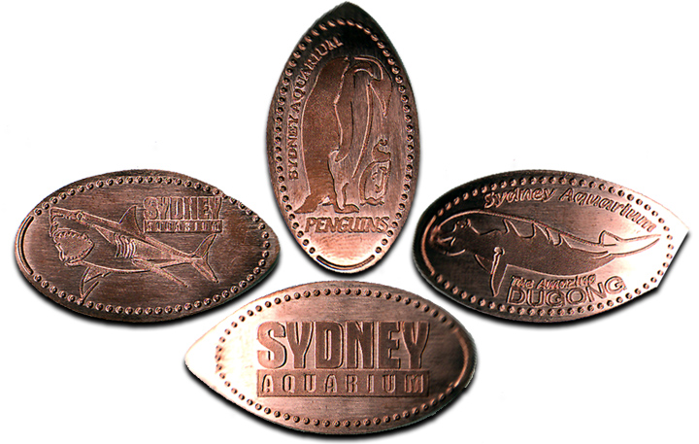
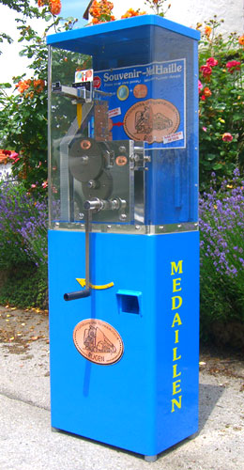
The purpose of the process…
Gal 4:19 Until Christ is formed in you
That the image of Christ may be imprinted on us
Until Jesus sees His image shining through us
Until then, we are not made perfect / complete!
Eph 4:13 “till we all come to the unity of the faith and of the knowledge of the Son of God, to a perfect man, to the measure of the stature of the fullness of Christ.”
Phil 2:12 “…work out your salvation with fear and trembling.”
Notes:
God writes every chapter and He isn’t finished with us until we come to that perfect/complete person. When we have come to the measure of the stature of the fullness of Christ.
Until then, we should not stop trying; we should not stop growing; we should not stop wanting more of God.

